Slide 1

Note: The data and information in this document is reflective of a hypothetical situation and client. This document is to be used for KPMG Virtual Internship purposes only.
Sprocket Central Pty Ltd
Data analytics approach
[Division Name] - [Engagement Manager], [Senior Consultant], [Junior Consultant]

Slide 2
Note: The data and information in this document is reflective of a hypothetical situation and client. This document is to be used for KPMG Virtual Internship purposes only.
Agenda
Introduction
Data Exploration
Model Development
Interpretation

Slide 3
Note: The data and information in this document is reflective of a hypothetical situation and client. This document is to be used for KPMG Virtual Internship purposes only.
Introduction
Identify the problem.
Data Analysis Approach.
Sprocket Central Pty Ltd is a company that specialize in high quality bikes and accessories.
The Marketing team wants to boost their sales.
They want to target 1000 new customers to bring the most value to the business.
Age Distribution
Bike related purchases for the last 3 years.
Job industry category
Wealth Segments by age category
Number of cars on each state
Customer profile

Slide 4
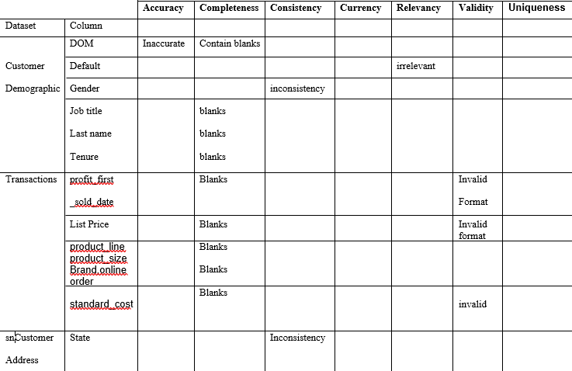
Data Exploration
Data Quality Assessment
Data Quality assessment for the Transaction, Customer Demographic and Customer Address datasets.

Slide 5
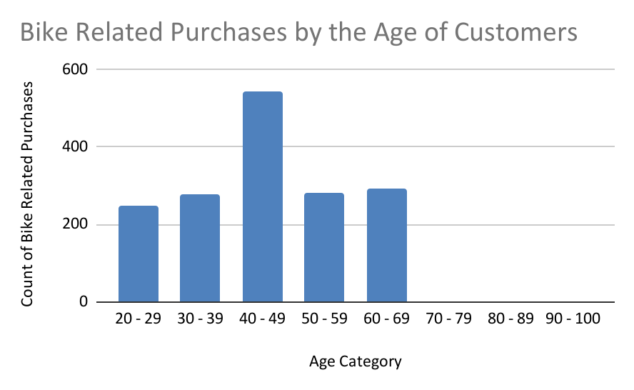
Data Extraction
Byke related purchases based on the Age of the customers
Most of the byke related purchases were made by customers between the age of 40 - 49.
Purchases ranges between the age of 20 to 69.

Slide 6
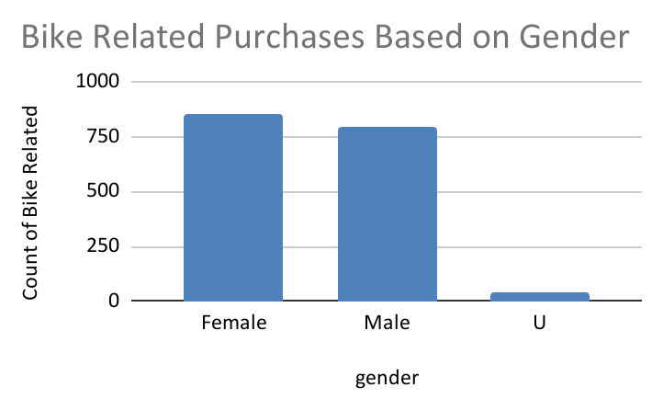
Data Extraction
Byke related purchases based on the Age of the customers
Females had a relatively high purchases compared to Males

Slide 7
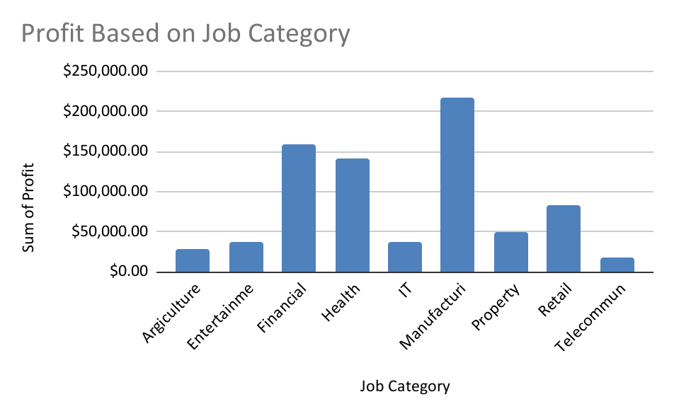
Note: The data and information in this document is reflective of a hypothetical situation and client. This document is to be used for KPMG Virtual Internship purposes only.
Model Development
Bike Related Purchases Based on Job Category.
The best three Job Category that generates more profit are Manufacturing, Financial, and Health services.
Most of the Job Category generate a profit less than $50,000.

Slide 8
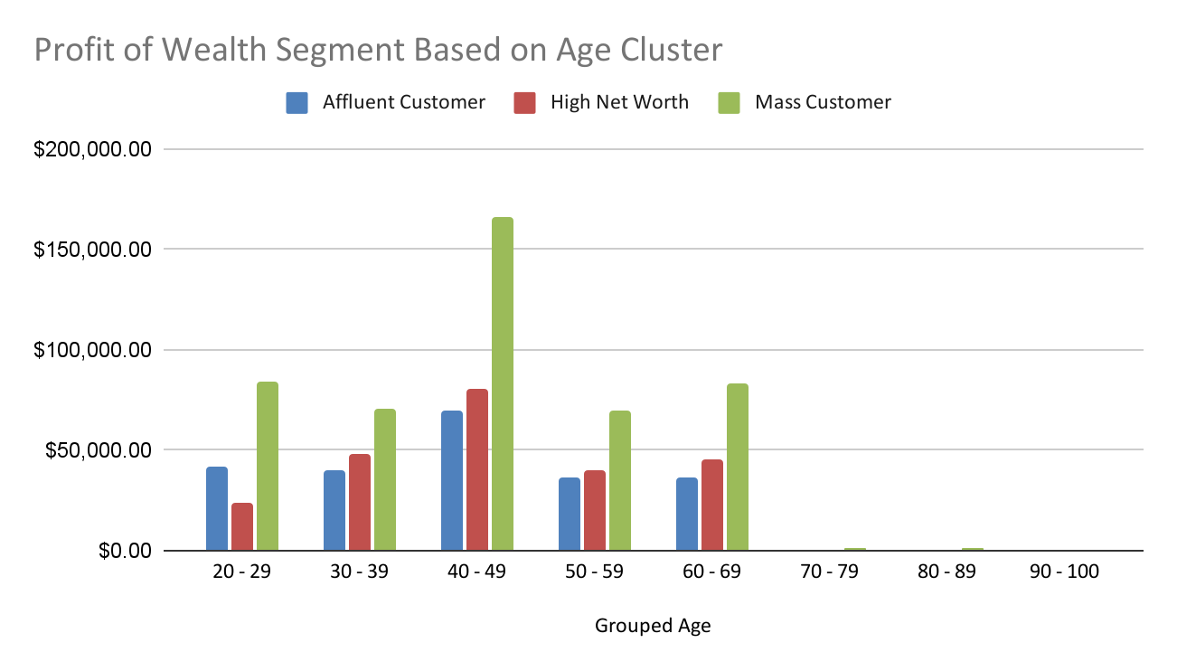
Note: The data and information in this document is reflective of a hypothetical situation and client. This document is to be used for KPMG Virtual Internship purposes only.
Model Development
Bike Related Purchases Based on Job Category.
Mass Customer segmentation generates the highest profit throughout the age clusters.
Customers between the Age of 40-49 generates the highest profit.
Mass Customer between the age of 40-49 generates the highest profit more than other clusters.

Slide 9
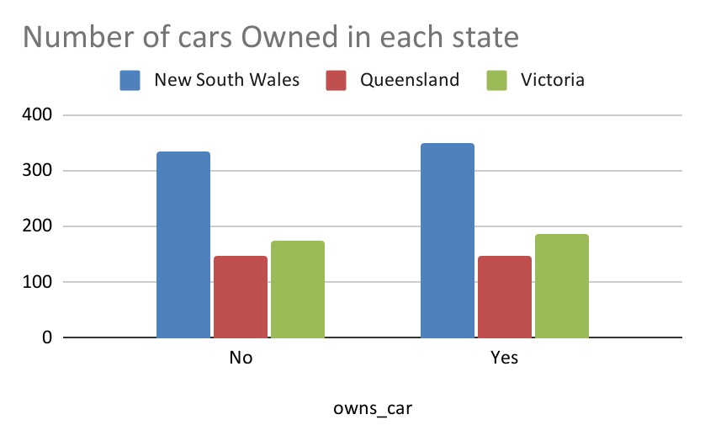
Note: The data and information in this document is reflective of a hypothetical situation and client. This document is to be used for KPMG Virtual Internship purposes only.
Model Development
Number of Cars owned in each State
New South Wales has many customers who own Cars, followed by Victoria, then Queensland.
Customers who don’t own cars are also many in New South Wales.

Slide 10
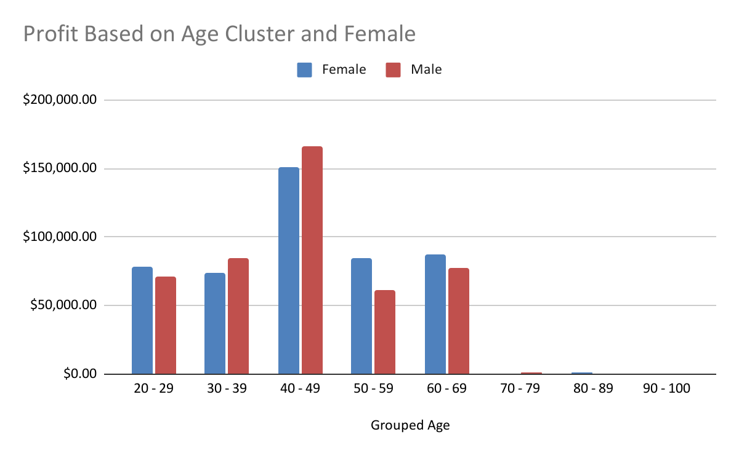
Model Development
Profit based on total number of customers and gender.
Customers of Age cluster between 40-49 generates more profit in both genders.

Slide 11
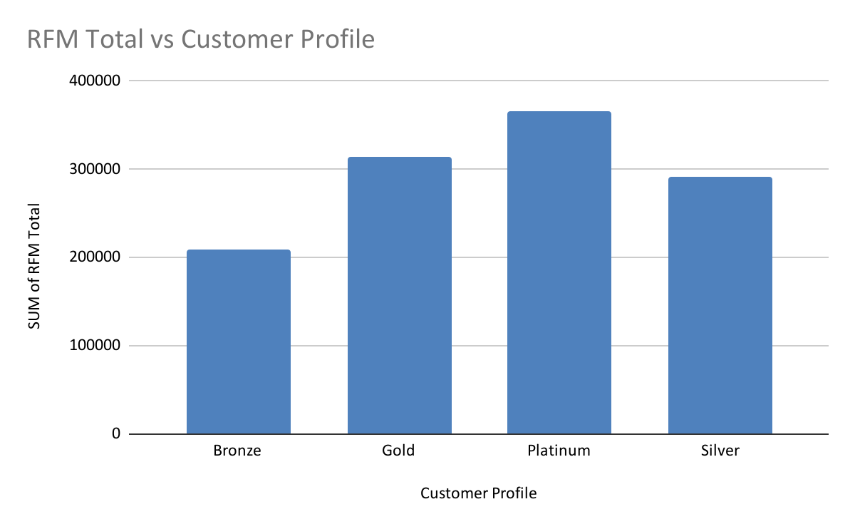
Model Development
RFM Analysis and Customer Profile
Based on the Recency of the purchase of the customer, frequency of the purchase and monetary, made a Customer Profile Visual.
Most of the customers are Platinum customers, followed by Gold, Silver and then Bronze.

Slide 12
Interpretation
Customer Classification: Targeting high value customers.
Based on the data analysis and the visuals generated. These are the high value customers that should be targeted.
Customers between the age of 40-49.
Customers who work in Manufacturing, Financial and Health industry.
Customers who are leaving in New South Wales, and Victoria States.
Most of the high value customers are females.
Most f the high value customers are of Mass Wealth Segment.

Slide 13
Note: The data and information in this document is reflective of a hypothetical situation and client. This document is to be used for KPMG Virtual Internship purposes only.
Thank you.

